Slide 1

ECEN 3593-001 Computer Organization
Lecture #24
17 March 2021

Slide 2


Agenda
Class Announcements
Midterm Review

Slide 3
Class Announcements
No reading assigned for the week
This week
MidTerm questions
Phase 7 information today
MidTerm on Friday

Slide 4
Class Announcements
Phase 6 is in the deduction period – 4%/day
Phase 7 Target Date Sunday, March 21 at 10:00
Bonus 1%/day (maximum 7%)
Deduction 4%/day after
Phase 8 will be posted late this week

Slide 5
Mid-Term
Mid-Term will be held in class on Friday, March 19
Mid-Term practice exam is posted
“Computer Organization and Design” text book, and RISC-V ISA specifications will be required for reference for figures as well as to create and decode RISC-V machine code
The Mid-Term will be taken through a Canvas quiz
50 minutes
1 attempt
Open Book, but not Open People, and not google

Slide 6
Mid-Term
Mid-Term compensation
4 questions similar to questions in homework #1 thru #3
Quiz bank of 12-18 questions
(estimating 30 minutes)
~50% of Mid-Term
15 multiple choice / matching questions
Quiz bank of 30-45 questions
Definitions / Theory based questions to test comprehension of the course material
(estimating 15 minutes)
~50% of Mid-Term
Suggestion: If you are stuck on a problem, make note of it and move on to complete other questions. Then go back and work on the problems that you passed over the first time
Do not lose the opportunity to complete questions that you know

Slide 7
Mid-Term
Don’t forget you have access to the Disassembler spreadsheet
The Instruction Format sheet is page 104 of the RISC-V Specification, which is available in Canvas.
Textbook Figure 4.19 is also posted in the RISC-V Documentation section in Canvas.
Both of these Figures will be necessary for the MidTerm Exam. I strongly suggest printing them or having them quickly available during the exam.

Slide 8
MidTerm Questions
????

Slide 9
Assembly -> Machine Code
What is the RISC-V machine code for the following assembly instruction?
bgeu x19, x26, -72
0b 1111 1011 1010 1001 1111 1100 1110 0011
What do we find first?
Opcode (and fn3)
What do we find next?
rs1 field
What do we find next?
rs2 field
Calculate the immediate

Slide 10
Calculate the Immediate -72
72 decimal = 1 * 2^6 = 64, remainder 72 – 64 = 8
8 decimal = 0b1000
72 decimal = 0b0000 0100 1000
-72 – 2’s complement
Invert = 0b1111 1011 0111
Add 1 = 0b1111 1011 1000
BUT – we divide by 2 (shift right 1)
Offset = 0b1111 1101 1100 (0)

Slide 11
Assembly -> Machine Code
What is the RISC-V machine code for the following assembly instruction?
bgeu x19, x26, -72
0b 1111 1011 1010 1001 1111 1100 1110 0011
0xFBA9FCE3
Calculate the immediate

Slide 12
Machine Code -> Assembly
What is the assembly instruction for the following RISC-V machine code:
0x5CE02E23
0b 0101 1100 1110 0000 0010 1110 0010 0011
sw x14, 1500(x0)
What do we do first?
Convert to binary
What do we find first?
Opcode and fn3
What do we find next?
rs1 and rs2 fields
Calculate the immediate

Slide 13
Calculate the Immediate 0b 0101 1101 1100
0b 0101 1101 1100
1 * 2^10 = 1024
1 * 2^8 = 256
1 * 2^7 = 128
1 * 2*6 = 64
1 * 2*4 = 16
1100 = 12
1024 + 256 + 128 + 64 + 16 + 12 = 1500

Slide 14
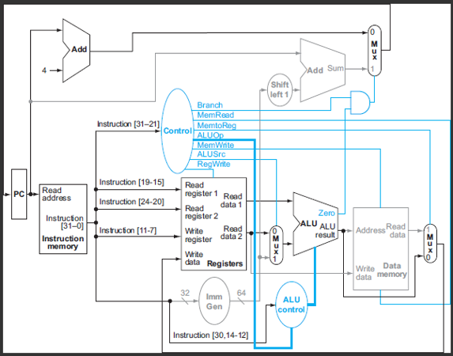
Control Signals/Resource Blocks
This is Figure 4.19 used in the MidTerm.
A “control signal” is asserted if it in the active state
A “resource block” is used if data flowing through it affects the value of an updated state element

Slide 15
Forwarding Analysis
Adding nops to Avoid Hazards
Forwarding Implemented
None
<- 2
<- 0
<- 2
<- 0
<- 0
<- 1
<- 0
<- 2
MEMWB
<- 1
<- 0
<- 1
<- 0
<- 0
<- 0
<- 0
<- 1
Both EXMEM and MEMWB
<- 0
<- 0
<- 1
<- 0
<- 0
<- 0
<- 0
<- 0
add x1, x2, x3
xori x4, x1, 47
lw x5, 24(x1)
bltu x4, x5,-40
or x7, x5, x7
sltiu x5, x1, x4
sh x7, 36(x1)
and x7, x5, x1
lw x8, -40(x7)

Slide 16
Pipeline Performance
Processor Clock Frequency
5 pipeline stages of a RISC-V CPU
IF (Instruction Fetch) 200ps
ID (Instruction Decode) 150ps
EX (Execution) 250ps
MEM (Memory Access) 200ps
WB (Write Back) 100ps
Single cycle instruction cycle time?
Single cycle instruction latency?
Pipelined cycle time?
Pipelined latency?
Divide 1 stage – which one?
900 ps
900 ps
250 ps
1250 ps
EX
900 ps
900 ps
200 ps
1200 ps

Slide 17
Phase 7
Maximum 11 ALU enums
Be alert for forward references

Slide 18
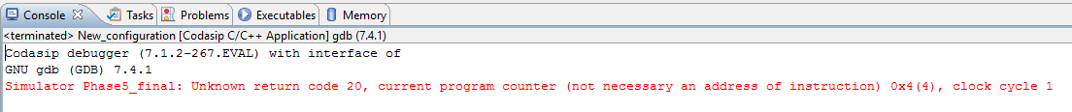
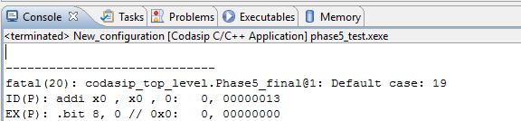
Class Project – Error Messages
Error message in gdb(7.4.1) console
Return code
Clock cycle (PC usually right)
Same error in the test console
Prints the bad code here

Slide 19
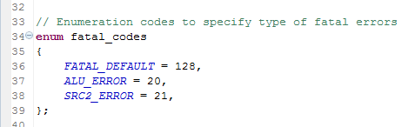
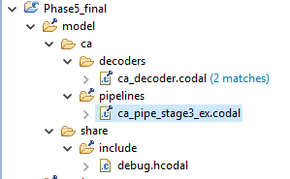
Class Project – Error Messages
What does the error code mean?
Look in debug.hcodal
Search for the code
Here is the definition
The error print is in one of these

Slide 20
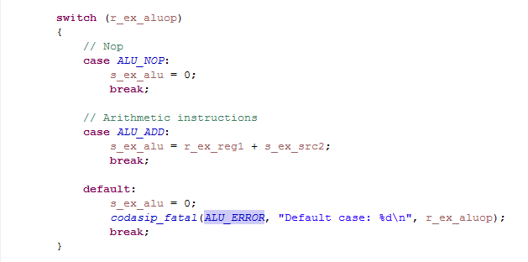
Class Project – Error Messages
Code in ca_pipe_stage3_ex.codal
The error code was 19 (0x13) which is larger than r_ex_aluop, so probably not here.

Slide 21
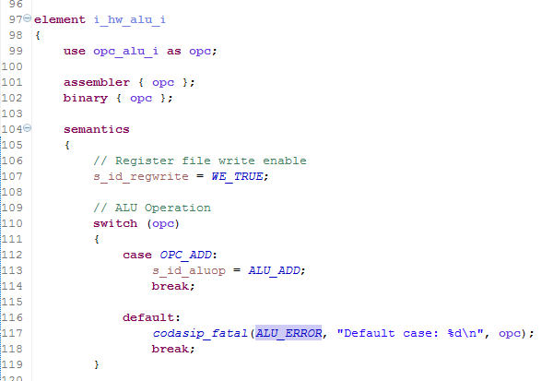
Class Project – Error Messages
Code in ca_decoders.codal
The error code was 19 (0x13).
What instruction is that?
Answer – OPC_ADDI
That isn’t a choice, but it’s decoded here!
Codasip_fatal causes the fatal error print in the gdb(7.4.1) console
The message print occurs in the test console

Slide 22
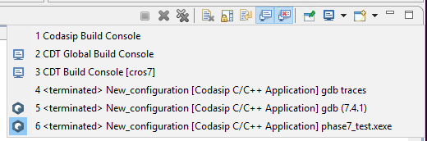
Class Project – Error Messages
If your test just terminates with no errors:
You have a fatal error but Codasip has switched Consoles
Pull down the Console select
Pick the (gdb 7.4.1) Console
You will see the error
The address is correct, and it is out of range
Bad branch/jump – use - -info 11 to debug

Slide 23
Class Project – Error Messages
You may also see the illegal instruction decode error at a valid address
This means you fetched an instruction from memory that the decoder doesn’t recognize
This also happened to some people in Phase 2
You may have the wrong instructions in an element (the opc_xxx value created in isa.codal)
You may have failed to include an element in the set dec statement in the decoder

